Slide 1
Synthesis Report: Costing Tool
EARLY GRADE READING SYNTHESIS AND LESSONS
Presentation by: Bianca Böhmer
Consultant
03 July 2025

Slide 2
Topics to be covered
EARLY GRADE READING SYNTHESIS AND LESSONS
Why did we build this costing tool?
What are the two EGRS costing tools?
How does the 2025 tool work?
5-Minute Excel tool run-through
Conclusion

Slide 3
Why produce a costing tool?
EARLY GRADE READING SYNTHESIS AND LESSONS
Produce 2025 EGRS cost estimates
Specific purpose: Produce costing estimates to compare the relative costs of various EGRS variants for use in the Synthes report for the WWHGE work
General refence for costing exercise
General purpose: Provide a very simple costing tool, that is accessible as a reference, which could be adjusted or expanded for more complex costing exercises.

Slide 4
General necessity of costing
EARLY GRADE READING SYNTHESIS AND LESSONS
Why are costing exercises useful?
Is it value for money?
How much would it cost?
How would costs be split?

Slide 5
General necessity of costing
EARLY GRADE READING SYNTHESIS AND LESSONS
Why are costing exercises useful?
Is it value for money?
Costing is critical to establish the efficiency of a programme (not only effectiveness). It is useful when differentiating between programmes or deciding on a specific programme.
How much would it cost?
Calculating the total cost allows for a feasibility assessment for a sustainable implementation, taking into account current and future budgets.
How would costs be split?
Operational planning for scaling may involve coordination across different departments or levels of government. Concrete costs help in this discussion.
NB: Such a costing exercise is never exact, but provides an estimates to facilitate planning around scale-up and potential costs

Slide 6
The two costing models
EARLY GRADE READING SYNTHESIS AND LESSONS
Differentiating between the 2020 and 2025 costing models
2020 Scale Costing Model
2025 per Teacher Costing Model
Excel model and a report
Produced by DNA Economics as a part of a 2020 UNICEF-funded scaling plans
Aimed to estimate the total programme cost of an EG reading scale-up
Incorporated scale-up assumptions by province
Assessed optimal designs - used these implementation models
Excel model with user guidelines
Produced in 2025 as a part of the WWHGE EGRS Synthesis Project
Aimed to produce an estimated per teacher (and per learner) cost of running an EG reading programme under different programme assumptions
Reported on evaluated models

Slide 7
How does the tool work?
EARLY GRADE READING SYNTHESIS AND LESSONS
Inputs
Calculations
Outputs
Unit Costs
Calculations: Model 1
Calculations: Model 2
Calculations: Model 3
Calculations: Model 4
Output
Calculations: Model 5
Calculations: Model 6
Assumptions
(Up to 10 simulations)
Calculations: Model 7
Calculations: Model 8
Calculations: Model 9
Calculations: Model 10

Slide 8
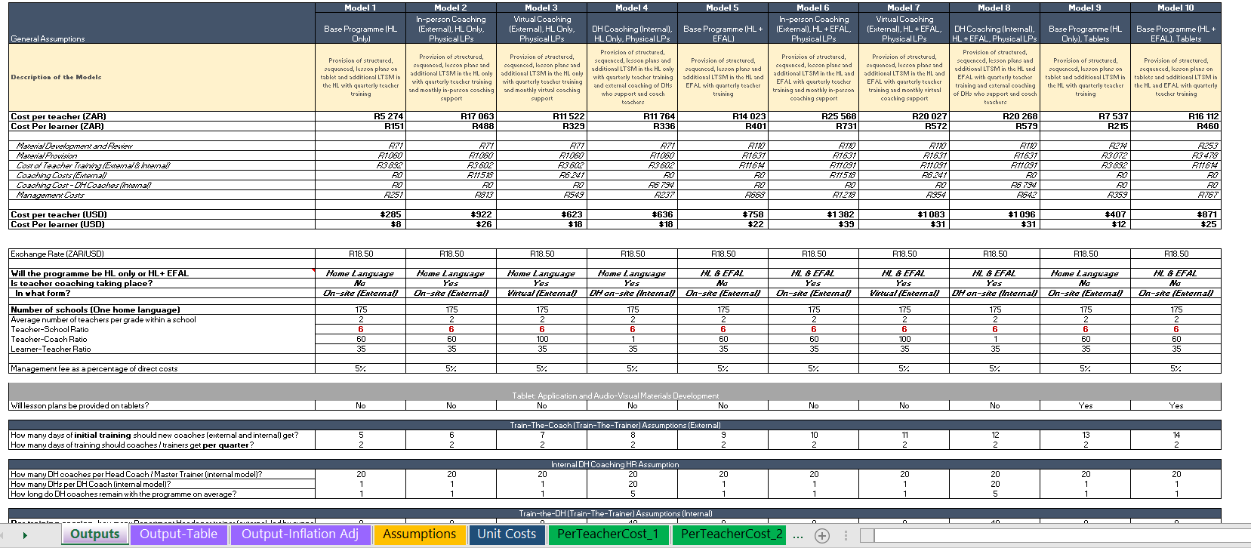
EARLY GRADE READING SYNTHESIS AND LESSONS
Excel run-through…

Slide 9
EARLY GRADE READING SYNTHESIS AND LESSONS
Conclusion
Impossible cost sweet-spot reflects two prevailing views
The impossible sweet spot
Low Cost
High Impact

Slide 10
EARLY GRADE READING SYNTHESIS AND LESSONS
Conclusion
Estimated cost are in the rage of similar national programme costs
~10.3 bn
National School Nutrition Programme
~7.0 bn*
Presidential Youth Employment Initiative’s
Basic Education Employment Intervention
~1.3 bn
DBE Rainbow workbooks
~0.7 bn
[Estimate for an early grade reading programme]
*Reported cost in 2023 adjusted to 2025 prices

Slide 11
EARLY GRADE READING SYNTHESIS AND LESSONS
Conclusion
Estimated cost and basic education priorities
0.2%
0.8%
Estimates programme cost as % of total Basic Education expenditure
Estimates programme cost as % of total non-COE Basic Education expenditure

Slide 12
EARLY GRADE READING SYNTHESIS AND LESSONS
Conclusion
Estimated cost and basic education priorities
0.2%
0.8%
Estimates programme cost as % of total Basic Education expenditure
Estimates programme cost as % of total non-CoE Basic Education expenditure
Cost alone is an insufficient reason to dismiss discussions of teacher support programmes in reading – it’s a question of priorities

Slide 13
Thank you

